Slide 1
Vision-Language Pre-training
Pengfeiwang
2023.06.16

Slide 2
Reference
GPT-4 Technical Report. Submitted on 15 Mar 2023
MiniGPT-4: Enhancing Vision-Language Understanding with Advanced Large Language Models. Submitted arxiv on 20 Apr 2023
Gan, Zhe, et al. "Vision-language pre-training: Basics, recent advances, and future trends." Foundations and Trends® in Computer Graphics and Vision 14.3–4 (2022): 163-352.
mPLUG-2: A Modularized Multi-modal Foundation Model Across Text, Image and Video.[c] ICML2023

Slide 3
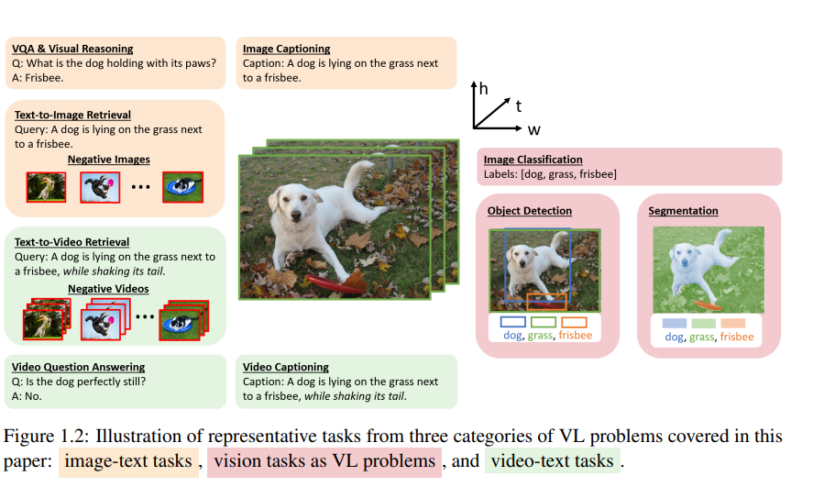
Background
Notes:
VQA and visual reasoning、Image captioning、Image-text retrieval、Visual grounding、Text-to-image generation

Slide 4
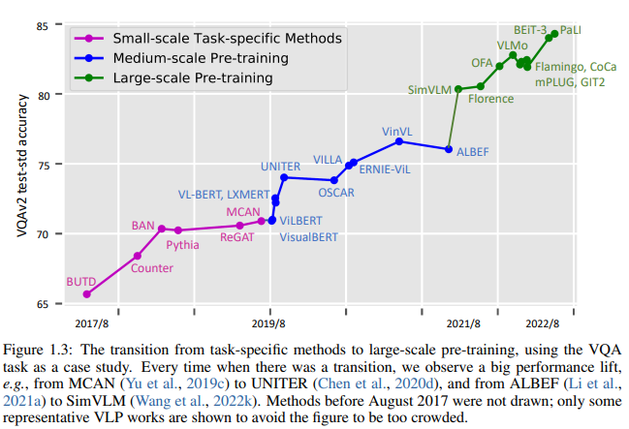
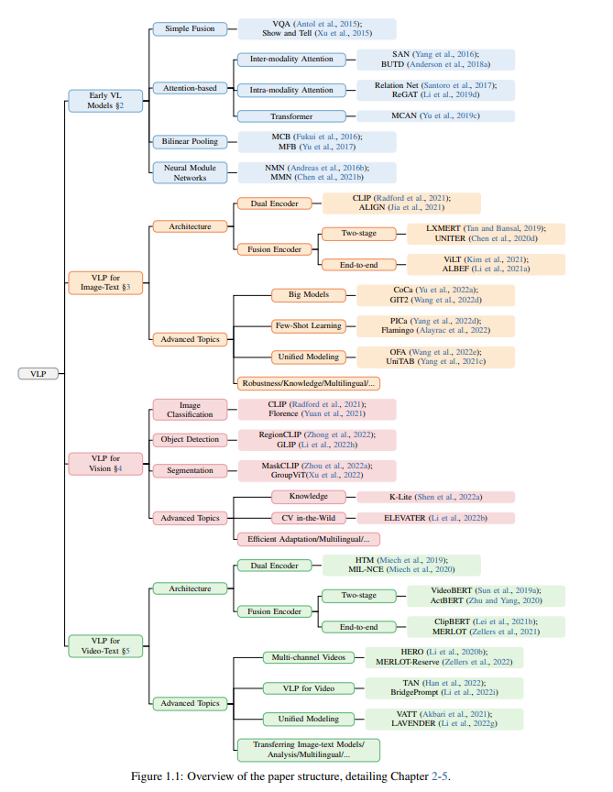
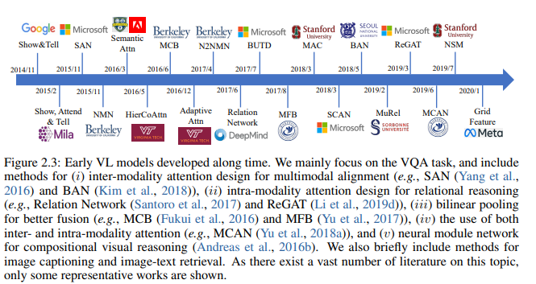
Background

Slide 5
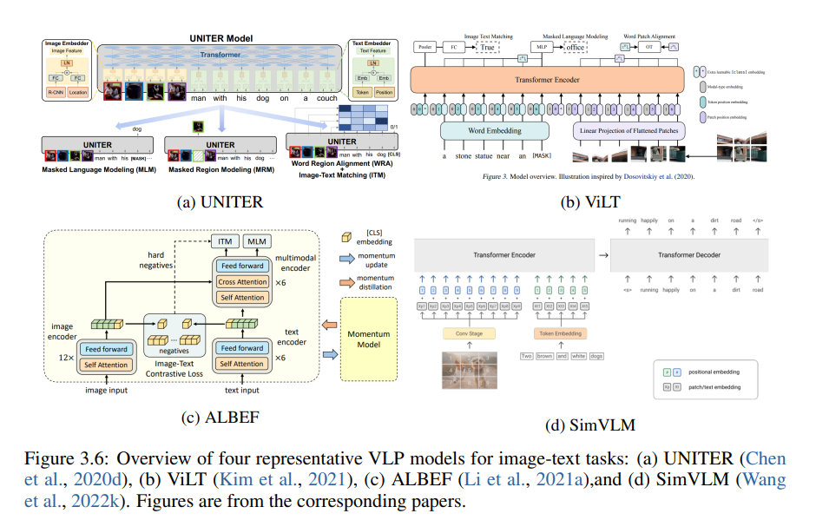
Backgroud

Slide 6
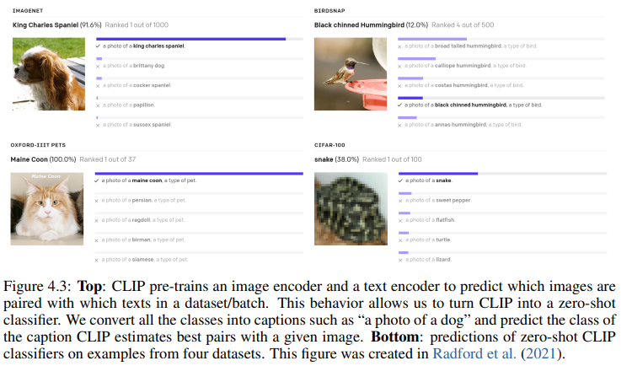
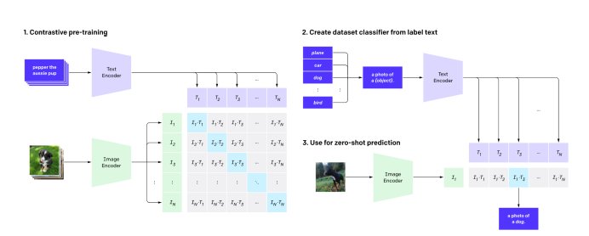
Background

Slide 7
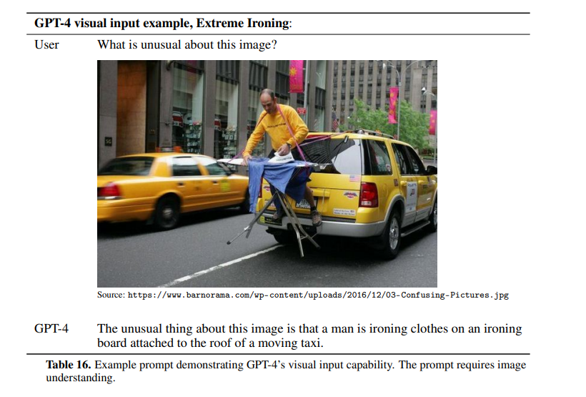
GPT-4

Slide 8
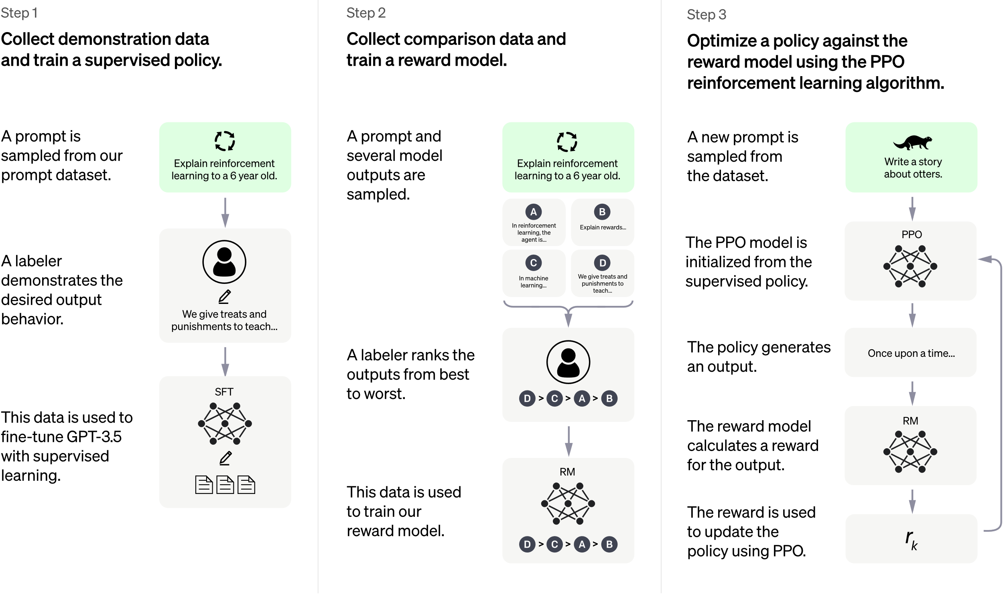
ChatGPT

Slide 9
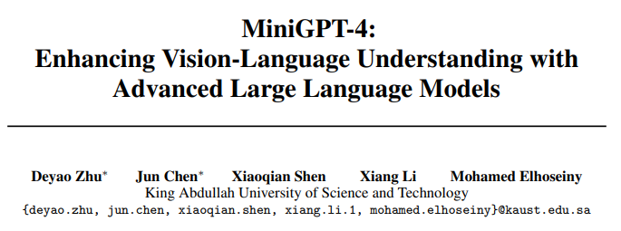
Notes:
阿卜杜拉国王科技大学

Slide 10
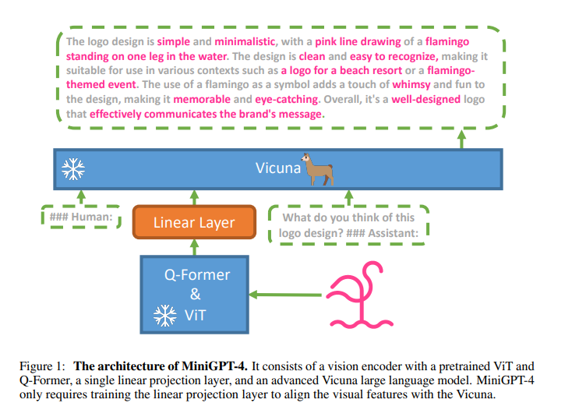
MiniGPT-4

Slide 11
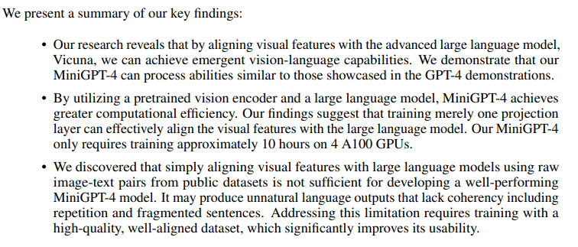
MiniGPT-4

Slide 12
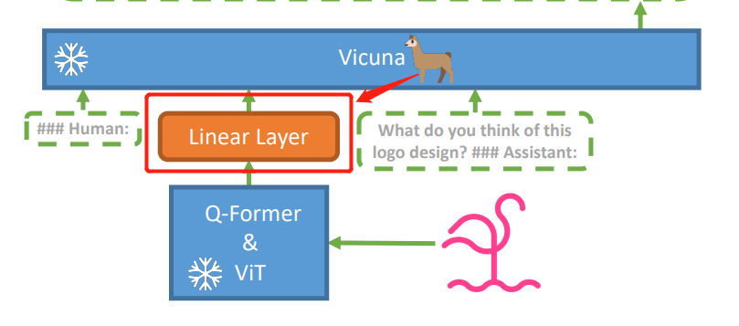
MiniGPT-4
Language model –Vicuna
Vision model - ViT-G/14 from EVA-CLIP and a Q-Former from BLIP-2
Two stage training

Slide 13
First pretraining stage
Process
Conceptual Caption, SBU and LAION-> 5 million image-text pairs.
20,000 training steps with a batch size of 256
4 A100 (80GB) GPUs-> 10 hours
Problem
Struggle to generate fluent and natural human language outputs at this stage
Not satisfy with the users’ intentions

Slide 14
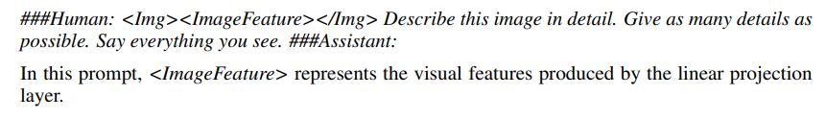
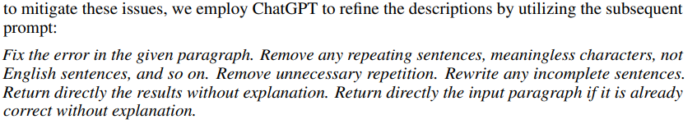
Curating a high-quality alignment dataset
Use first pretraining stage to generate a comprehensive description of a given image.
Notes:
5000->3500

Slide 15
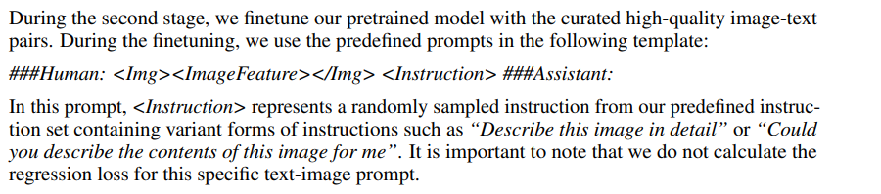
Second-stage finetuning

Slide 16
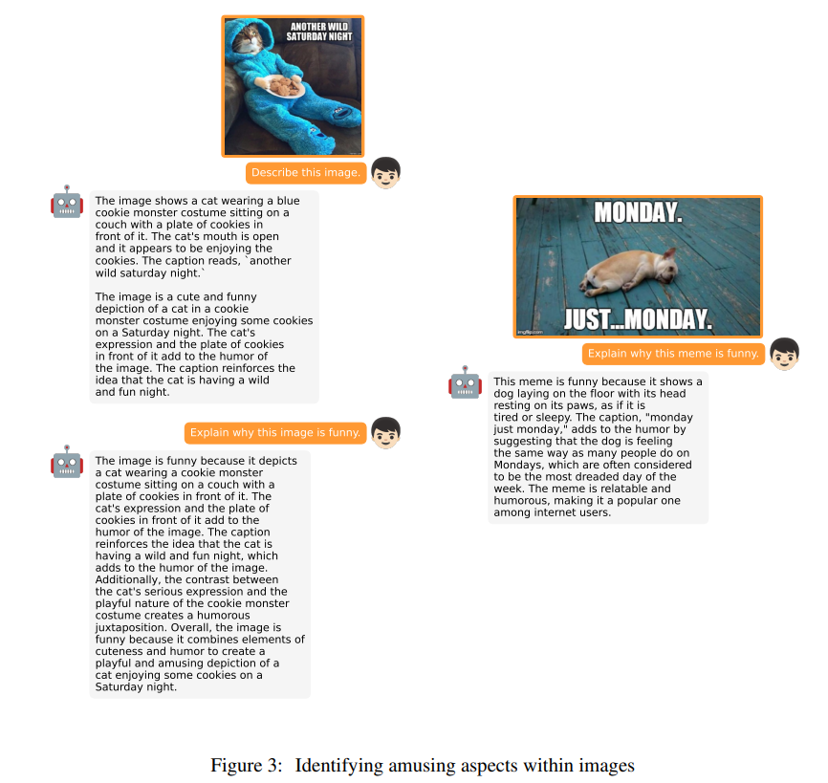
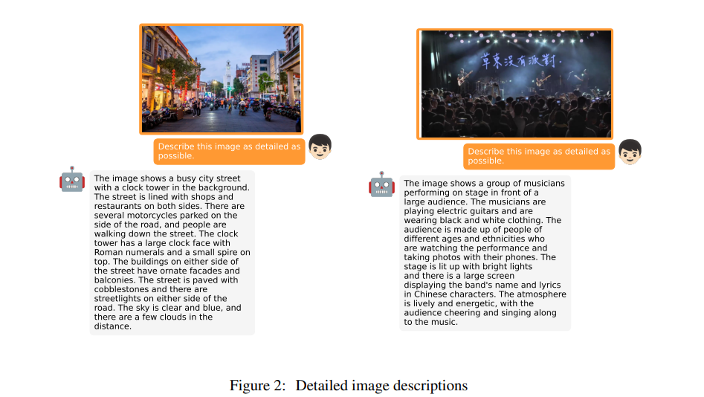
Demonstrations

Slide 17
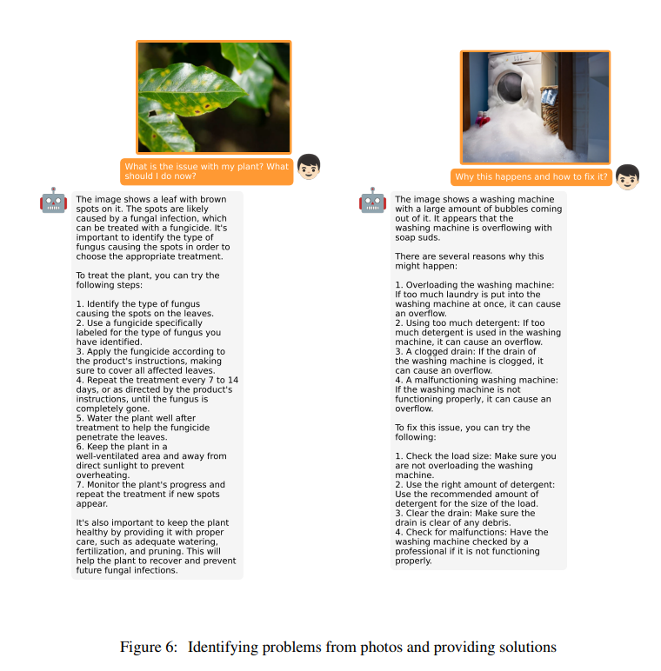
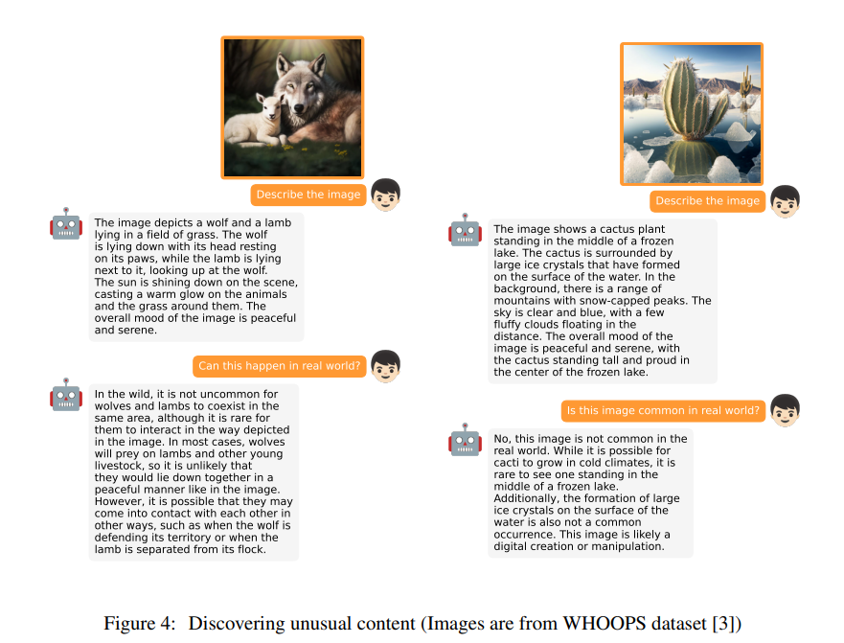
Result

Slide 18
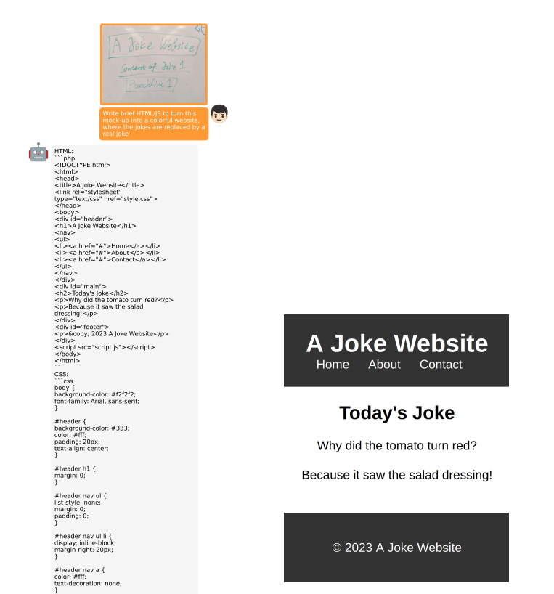
Result

Slide 19
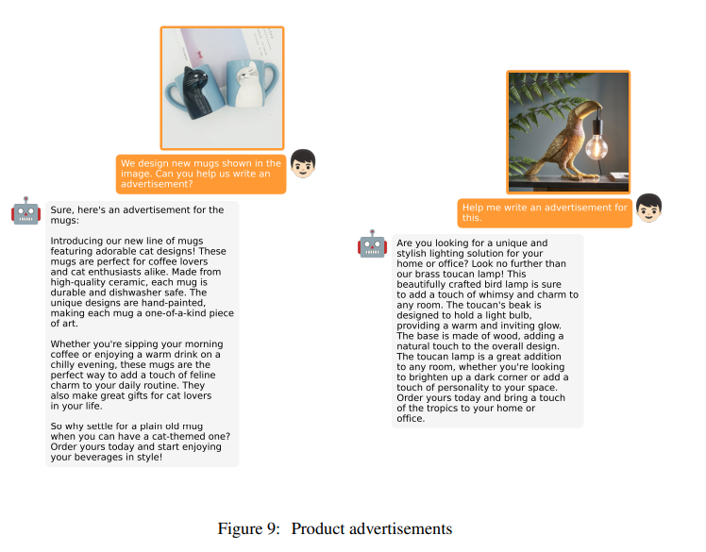
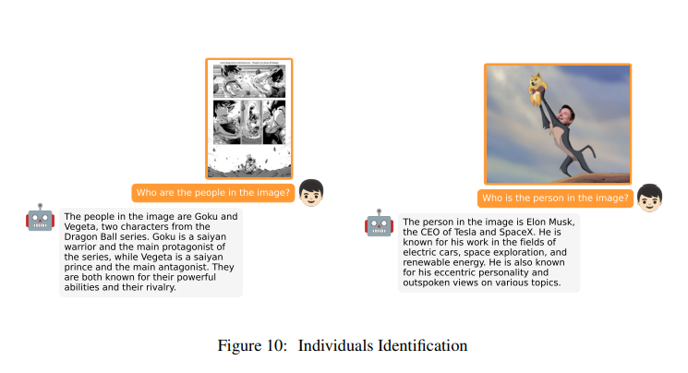
Result

Slide 20
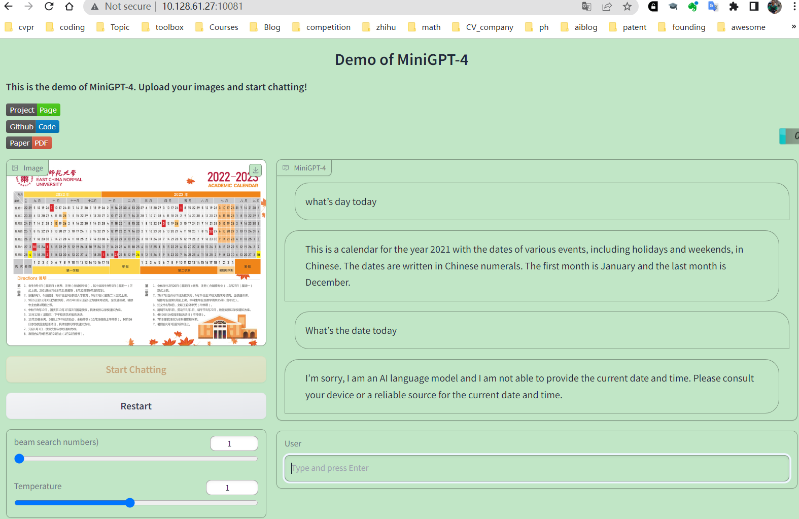
Result

Slide 21
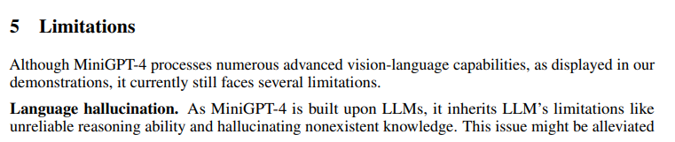
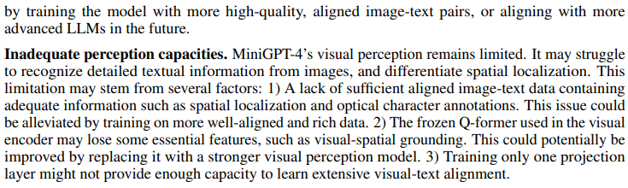
Limitations

Slide 22
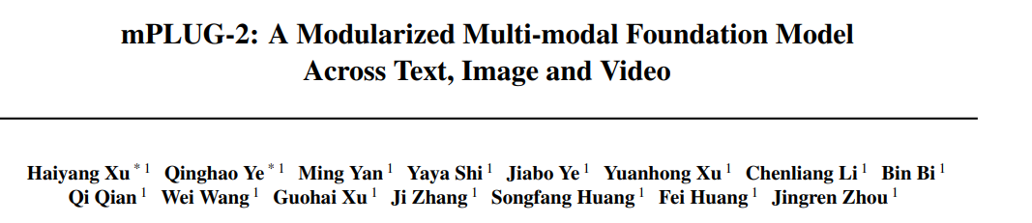
ICML 2023预讲会（一）-来自CMU、清华、UIUC等五位一作作者_哔哩哔哩_bilibili

Slide 23
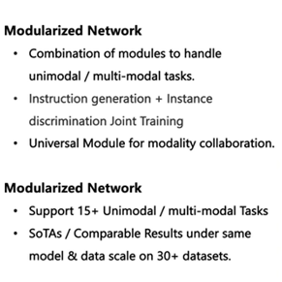
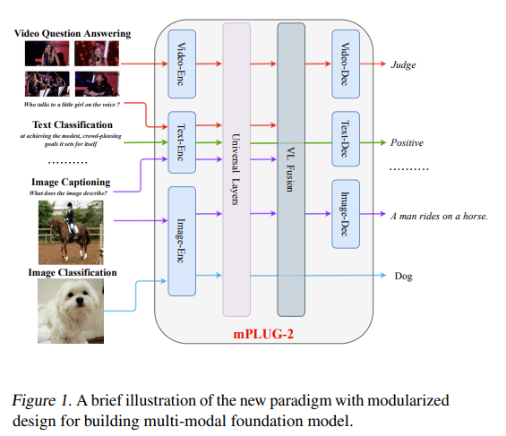
Motivation

Slide 24
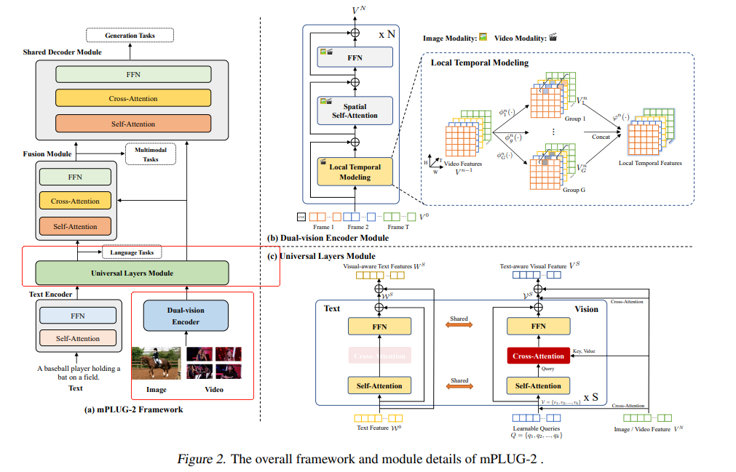
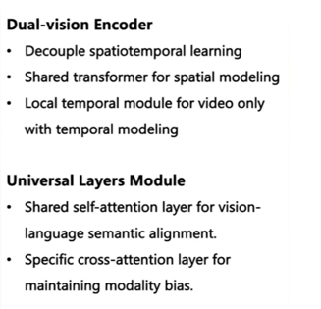
Overall framewok

Slide 25
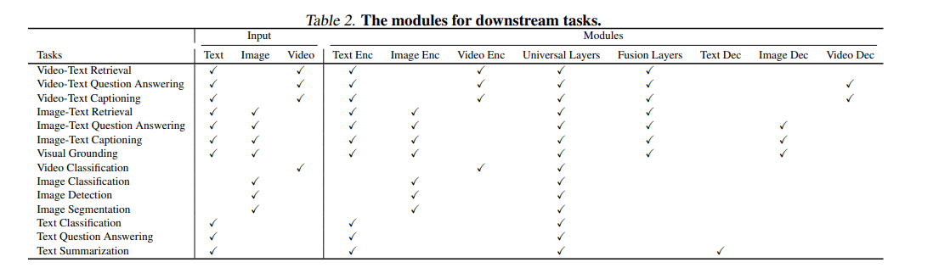
mPlug-2

Slide 26
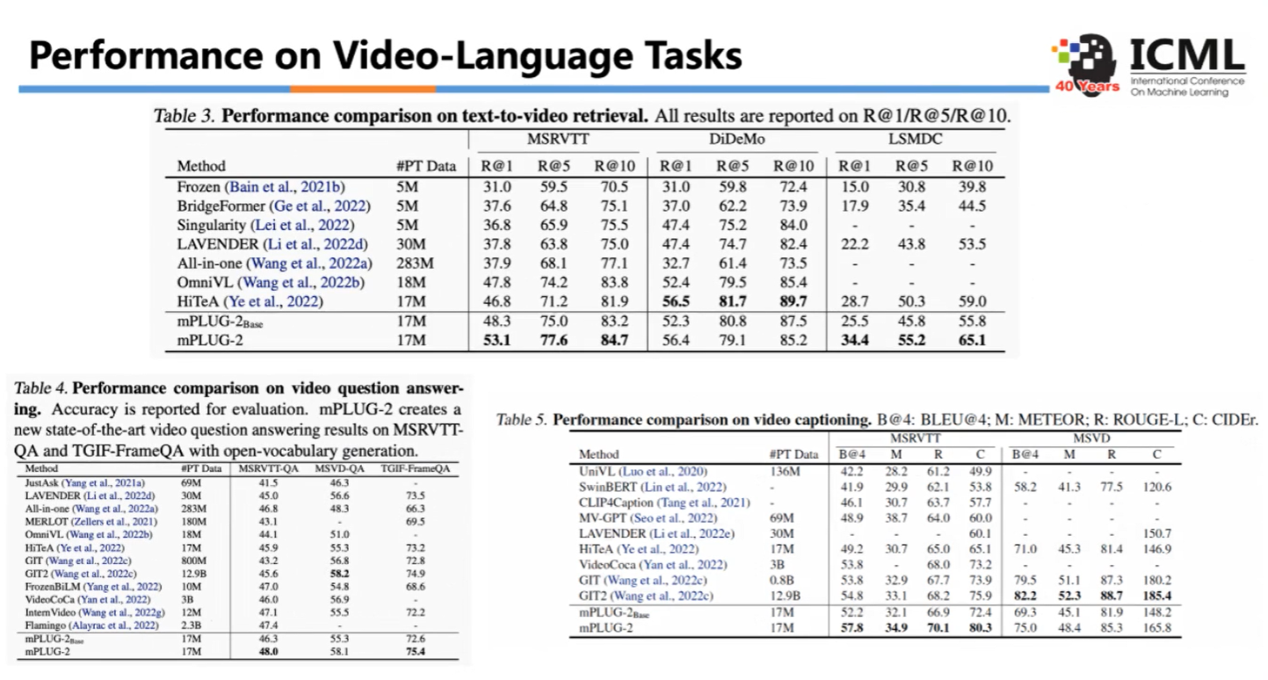

Slide 27
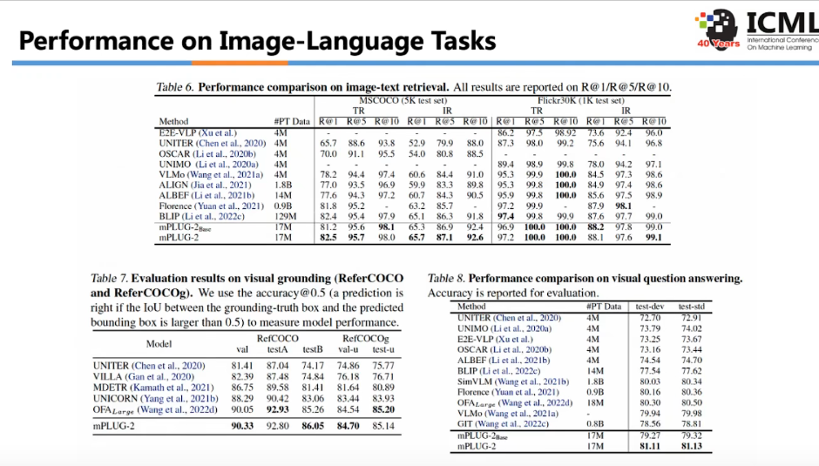

Slide 28
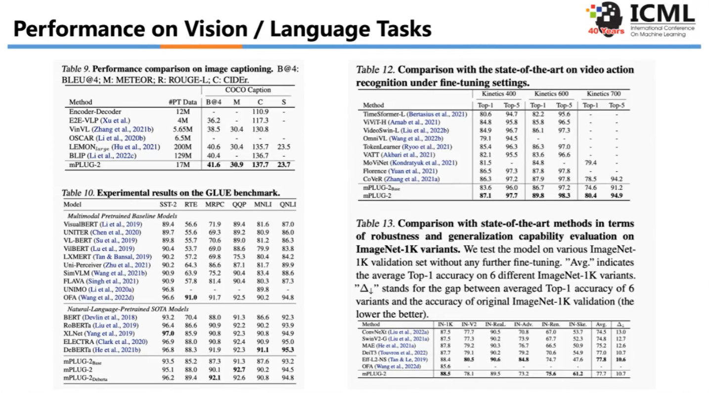
Notes:
单一模态任务上也ok

Slide 29
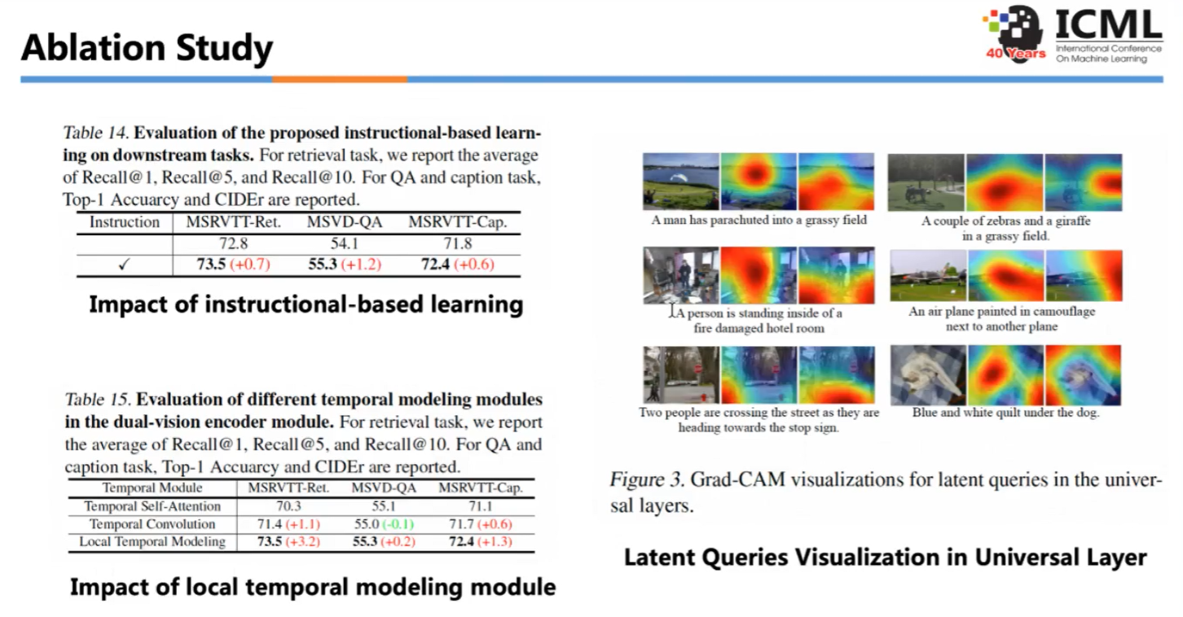

Slide 30
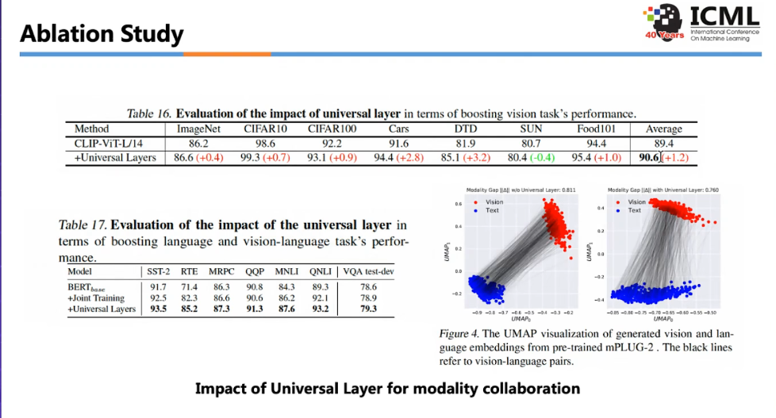

Slide 31
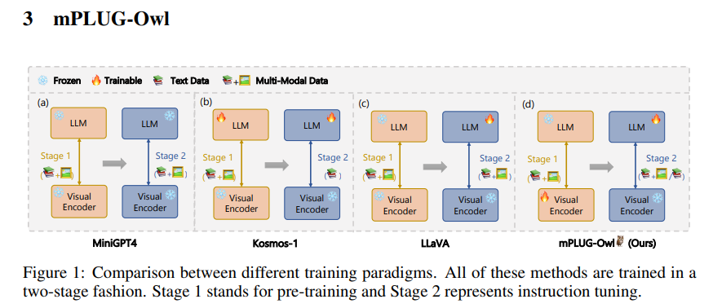
Ye, Qinghao, et al. "mplug-owl: Modularization empowers large language models with multimodality." arXiv preprint arXiv:2304.14178 (2023).

Slide 32
Conclusion
Share embedding space or torwards to one space?
how to slim?
how to use the knowledeg of big model?
More modalities?

